Slide 1

HOW OLIST CAN INCREASE REVENUE?
TOMS BALTMUGURIS
Notes:
Maybe a bit more text

Slide 2
STRUCTURE
Installments
Freight cost
Late deliveries
Notes:
Presentation for department managers

Slide 3
Why should we care about installments?

Slide 4
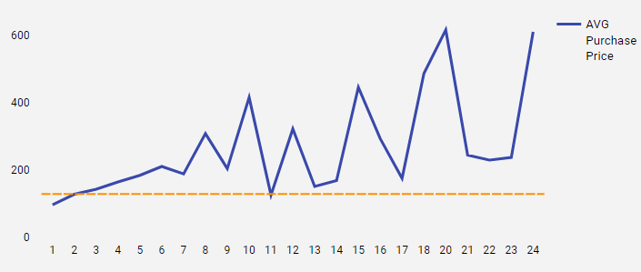
1) INSTALLMENT PAYMENT ANALYSIS
127.96 - Average purchase price without installments
Most expensive purchases - the longest timeframe taken
Notes:
Axis names
Clients buying the most expensive items are more willing to pay in installments.
From this graph we can see that the bigger the purchase, the bigger the timeframe taken to repay money is taken.
Not introducing availability to these installments could be slowing down the business.

Slide 5
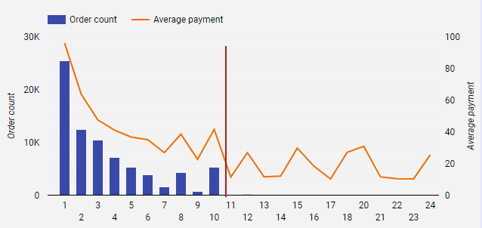
1) INSTALLMENT PAYMENT ANALYSIS
A potential problem -installments longer than 10 months
Notes:
*Description of the table*
So, why I am mentioning it? Here it is. *Mention potential problem*
This would help to solve multiple problems for the business:
Increased stability for a business - less impact from seasonality.
More stable cash flow - better terms for bank loans, factoring and other measures a business of this scale needs.

Slide 6
WHAT CAN BE DONE?
1
ENCOURAGE MORE PAYMENTS IN INSTALLMENTS
Stable cash flow for longer periods, better terms for financing.
2
LONGER PAYMENT INSTALLMENT AVAILABILITY
Make longer payment installments available, but an interest rate system is needed.
3
Notes:
(Interest rate should be added if payment stretched out for longer than 10 months)

Slide 7
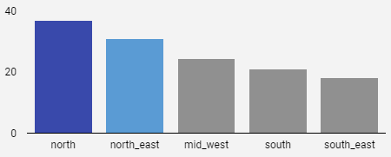
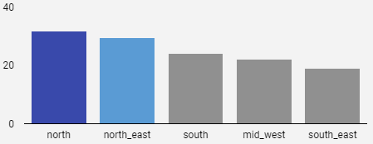
2) Freight costs
Customers
Sellers
Notes:
North freight costs are almost 2x as expensive from both sides, seller and cutomer. To try to understand more, we need to dive in deeper.

Slide 8
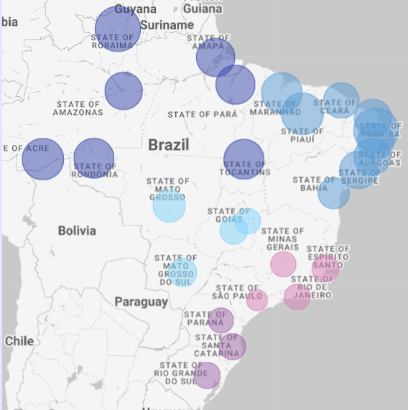
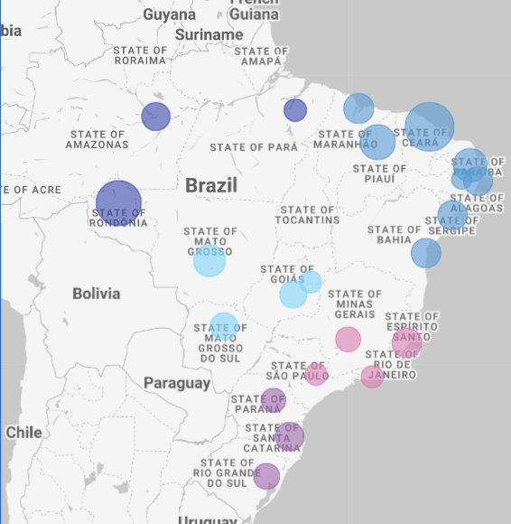
2) Freight costs
Customers
Sellers
Notes:
North freights are more expensive due to lach of sellers in the region. Further shipping → higher costs.

Slide 9
WHAT CAN BE DONE?
1
SHORT TERM SOLUTION: LOGISTICS PROGRAM REORGANISATION
Find a non-competitive firm that also ships to Northern Brazil. To minimize shipping costs, create a united shipping company.
Maybe little revenue is due to high freight costs?
2
CREATE SELLERS IN NORTHERN PART OF THE COUNTRY
Some masterclasses should be organized to increase sellers in Northern part of Brazil.
3
Notes:
Calculate potential uplift

Slide 10
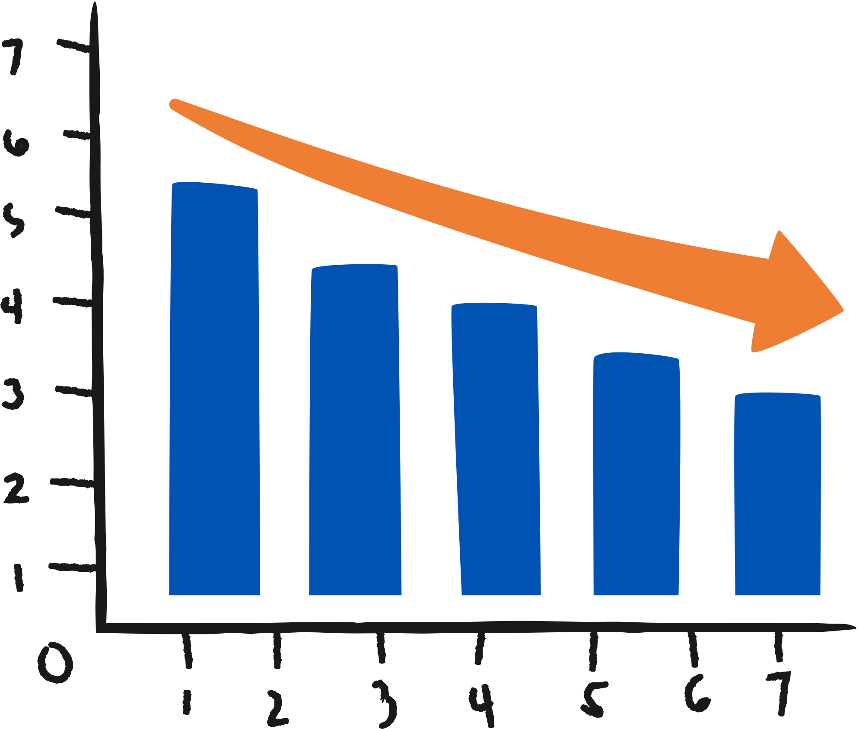

3) Late Deliveries
Latest deliveries:
Fastest deliveries:
Worst categories:
Best categories
Audio
Fashion underwear – Beach
Christmas supplies
Books imported
Air conditioning
Fixed telephony
Worst cities:
Best cities:
Sao Luis
Sao Paulo
Foz do iguacu
Cornelio Procopio
Icara
Tres Rios
Notes:
More data – actual numbers

Slide 11
WHAT CAN BE DONE?
WORST VS BEST PRACTICES
The company quickly needs to focus on its worst-rated categories and cities. Some masterclasses should be organized. Additionally, the company should focus on logistics for bad performing cities

Slide 12
ACTION PLAN
INSTALLMENTS
IT team: Intallment problem + Implementation
Financial specialist: development of interest rate algorithm
Marketing: Announcement of longer installments
FREIGHT
Business center: Search for firms to collaborate with
HR team: Preparing material for new sellers
Marketing: Ad campaign for Northern region sellers
LATE DELIVERIES
Logistics + Sales + Business team: Conduct research into Worst vs Best delivering companies
Implement the best practice differences on worst categories and states

